Slide 1
Human Activity Recognition
Edwin Candinegara

Slide 2
Objectives
Real-time Smartphone based Human Activity Recognition
Smartwatch based Human Activity Recognition

Slide 3
Low Level Activities
Duration: 15 mins / activity
Activities:
Walking
Running
Laying down
Sitting
Standing
Brushing
Typing

Slide 4
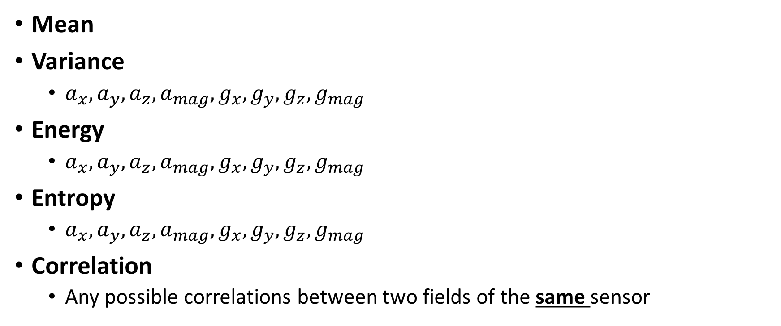
Features
Mean
Variance
$a_{x},a_{y},a_{z},a_{mag},g_{x},g_{y},g_{z},g_{mag}$
Energy
$a_{x},a_{y},a_{z},a_{mag},g_{x},g_{y},g_{z},g_{mag}$
Entropy
$a_{x},a_{y},a_{z},a_{mag},g_{x},g_{y},g_{z},g_{mag}$
Correlation
Any possible correlations between two fields of the same sensor

Slide 5
Models
SVM
Naive Bayes
Random Forest
Neural Network
Ensemble of the methods above
Majority voting
Neural network

